Slide 1
BMC Cyber and Cloud Summer Courses Deep Learning for Computer Vision Overview of Deep Learning
Samuel Adebayo
sadebayo@belfastmet.ac.uk

Slide 2
Agenda
LeNet-5 (1998)
AlexNet (2012)
VGG (2014)

Slide 3
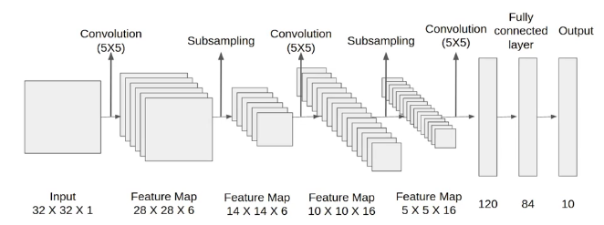
LeNet-5 (1998)
Overview:
Developed by Yann LeCun and colleagues in 1998, LeNet-5 is one of the first convolutional neural networks (CNNs) designed for handwritten digit recognition, specifically for the MNIST dataset.
It consists of seven layers (excluding input), including two convolutional layers, two subsampling layers (akin to max pooling), and three fully connected layers.
Key Contributions:
Introduction of Convolutional and Pooling Layers: LeNet-5 popularised the use of convolutional layers to automatically learn spatial hierarchies of features from data and pooling layers to reduce dimensionality while preserving important features.
Early Success in Computer Vision: It demonstrated the practical utility of CNNs in automating the feature extraction process, which was a significant step forward from traditional methods.
Architecture:
Input: 32x32 pixel images
Layers: Conv1 → Subsampling → Conv2 → Subsampling → FC1 → FC2 → Output
References:
LeCun, Y., Bottou, L., Bengio, Y., & Haffner, P. (1998). Gradient-based learning applied to document recognition. Proceedings of the IEEE, 86(11), 2278-2324.

Slide 4
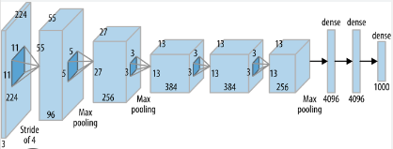
AlexNet (2012)
Overview:
Developed by Alex Krizhevsky, Ilya Sutskever, and Geoffrey Hinton, AlexNet was a groundbreaking CNN architecture that won the ImageNet Large Scale Visual Recognition Challenge (ILSVRC) in 2012 by a significant margin.
It demonstrated the power of deep learning in computer vision, particularly for large-scale image classification tasks.
Key Contributions:
Deeper Architecture: AlexNet had eight layers (five convolutional and three fully connected), significantly deeper than previous networks.
Use of ReLU and Dropout: Introduced Rectified Linear Unit (ReLU) activation function for faster training and dropout to reduce overfitting.
GPU Utilisation: AlexNet was one of the first CNNs to effectively leverage GPUs for training, which enabled the training of deep networks on large datasets.
Architecture:
Input: 224x224 RGB images
Layers: Conv1 → Max Pooling → Conv2 → Max Pooling → Conv3 → Conv4 → Conv5 → Max Pooling → FC1 → Dropout → FC2 → Dropout → Output
References:
Krizhevsky, A., Sutskever, I., & Hinton, G. E. (2012). ImageNet classification with deep convolutional neural networks. Advances in Neural Information Processing Systems, 25, 1097-1105.

Slide 5
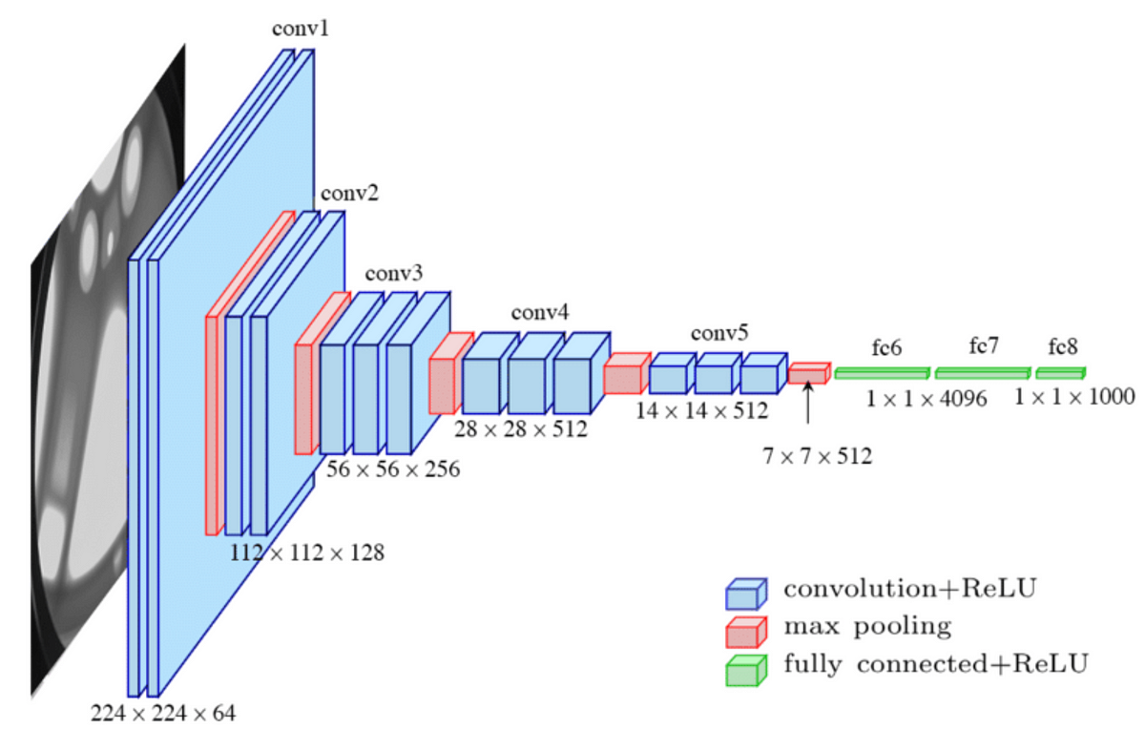
VGG (2014)
Overview:
Developed by the Visual Geometry Group at the University of Oxford, VGG networks (VGG-16 and VGG-19) are known for their simplicity and uniform architecture, which was a departure from previous models.
It placed second in the ILSVRC 2014 but was highly influential due to its contribution to architectural design principles.
Key Contributions:
Depth with Simplicity: VGG demonstrated that increasing the depth of the network with smaller 3x3 convolutional filters could improve performance. This simplicity in design (use of same-sized filters) made the architecture easier to implement and understand.
Uniform Architecture: The network is characterised by stacking multiple convolutional layers, each followed by ReLU activation and max-pooling, to progressively reduce the spatial dimensions while increasing the depth.
Architecture:
Input: 224x224 RGB images
Layers: Conv3-64 → Conv3-64 → Max Pool → Conv3-128 → Conv3-128 → Max Pool → Conv3-256 → Conv3-256 → Conv3-256 → Max Pool → Conv3-512 → Conv3-512 → Conv3-512 → Max Pool → Conv3-512 → Conv3-512 → Conv3-512 → Max Pool → FC4096 → Dropout → FC4096 → Dropout → Output
References:
Simonyan, K., & Zisserman, A. (2014). Very deep convolutional networks for large-scale image recognition. arXiv preprint arXiv:1409.1556.

Slide 6
Comparison of CNN Architectures
LeNet-5: Suitable for small-scale tasks like digit recognition. Simplicity in architecture made it a starting point for CNNs.
AlexNet: Marked the transition to deep networks with a focus on handling large-scale image data and effective training techniques like ReLU and dropout.
VGG: Emphasised depth and uniform architecture, setting the stage for even deeper and more complex networks. It showed that depth alone could significantly boost performance.
Performance and Impact:
LeNet-5: Revolutionised digit recognition tasks.
AlexNet: Established deep learning as a powerful tool in computer vision.
VGG: Became a foundational architecture influencing the design of subsequent models, despite its high computational cost.

Slide 7

Questions?

Slide 8

Thank You
See you soon

